Slide 1
Hospitality Analysis
SQL Power | BI | Tableau | Excel Dashboard Project

Slide 2
MEET OUR TEAM
A C Deeksha
D Kushwanth
Ellutla Dinesh
MAHI MITHRA.R
Vaishno Sharma
Manasi Ratnakar Tupe
GROUP 6

Slide 3
AGENDA
Introduction
Project overview
Key KPIs 1. Revenue 2. Occupancy rate 3. Average daily rate 4. Revenue per available room
Dashboards 1. Excel 2. PowerBi 3. Tableau
Recommendations
Conclusion

Slide 4
Introduction
The hospitality industry generates large volumes of operational and transactional data related to bookings, revenue, occupancy, and pricing. To remain competitive, organizations need the ability to transform this raw data into meaningful insights that support strategic decision-making. This project will leverage modern data analytics tools such as Excel, Tableau, and Power BI to analyze hotel performance and visualize key business metrics. By using interactive dashboards, the analysis enables stakeholders for quickly understanding trends, compare performance across properties and cities, and identify areas for improvement.

Slide 5
Project Overview
This project focuses on analyzing hospitality business performance using a combination of Excel for data preparation, Tableau for detailed exploratory analysis, and Power BI for interactive and executive-level dashboards. The dataset includes booking information, property details, revenue metrics, and time-based data, which were cleaned, validated, and transformed to ensure accuracy. Key hospitality KPIs such as Revenue, Occupancy Rate, Average Daily Rate (ADR), and Revenue per Available Room (RevPAR) were calculated and visualized. The dashboards provide a consolidated view of performance across different locations and time periods, enabling data-driven insights into demand patterns, pricing efficiency, and overall revenue performance.

Slide 6
Key KPIS
Revenue
Occupancy rate
Average daily rate
Revenue per available room

Slide 7
Revenue
Revenue represents the total income generated from room bookings over a selected time period. It is calculated by summing the room revenue from all confirmed bookings. This KPI provides a direct measure of the overall financial performance of the hospitality business. In the Power BI and Tableau dashboards, revenue is analyzed across cities, properties, and time periods to identify growth trends, top-performing locations, and periods of high or low demand.

Slide 8
Occupancy rate
Occupancy Rate measures the percentage of available rooms that are occupied during a given period. It is calculated by dividing the number of rooms sold by the total number of rooms available. This KPI reflects customer demand and capacity utilization. Through the dashboards, occupancy trends help identify peak seasons, off-peak periods, and underutilized properties, enabling better demand management and operational planning.

Slide 9
Average Daily Rate (ADR)
ADR, or Average Daily Rate, represents the average revenue earned per occupied room. It is calculated by dividing total room revenue by the number of rooms sold. ADR focuses on pricing performance rather than volume. In the dashboards, ADR is used to compare pricing strategies across different hotels and locations and to assess whether rooms are being sold at optimal rates.

Slide 10
Revenue per Available Room (RevPAR)
RevPAR, or Revenue per Available Room, combines both occupancy and pricing efficiency into a single metric. It is calculated either by multiplying ADR by the occupancy rate or by dividing total room revenue by the total number of available rooms. RevPAR is one of the most critical KPIs in the hospitality industry, as it indicates how effectively a property is generating revenue from its available inventory. The dashboards use RevPAR to identify high-performing properties and areas where pricing or demand strategies need improvement.

Slide 11
DASHBOARD
Excel
PowerBi
Tableau

Slide 12
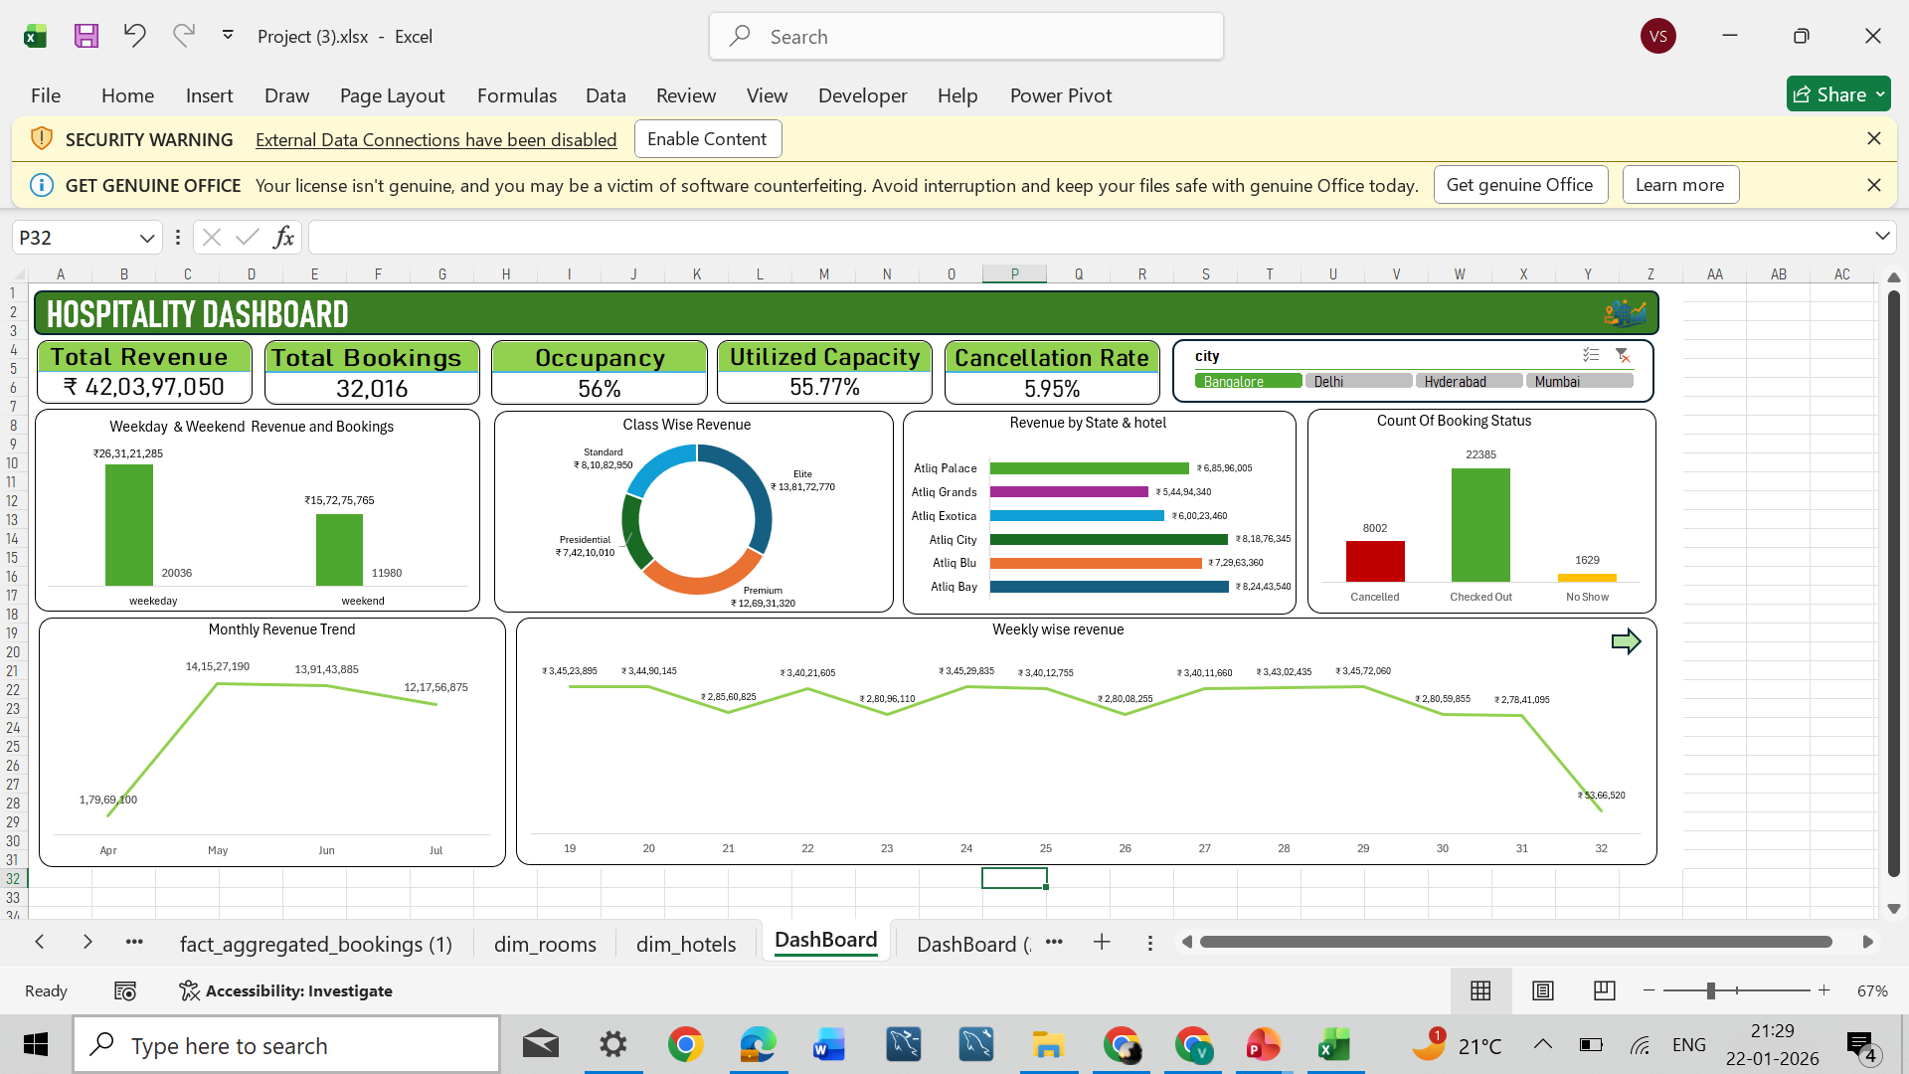
Excel

Slide 13
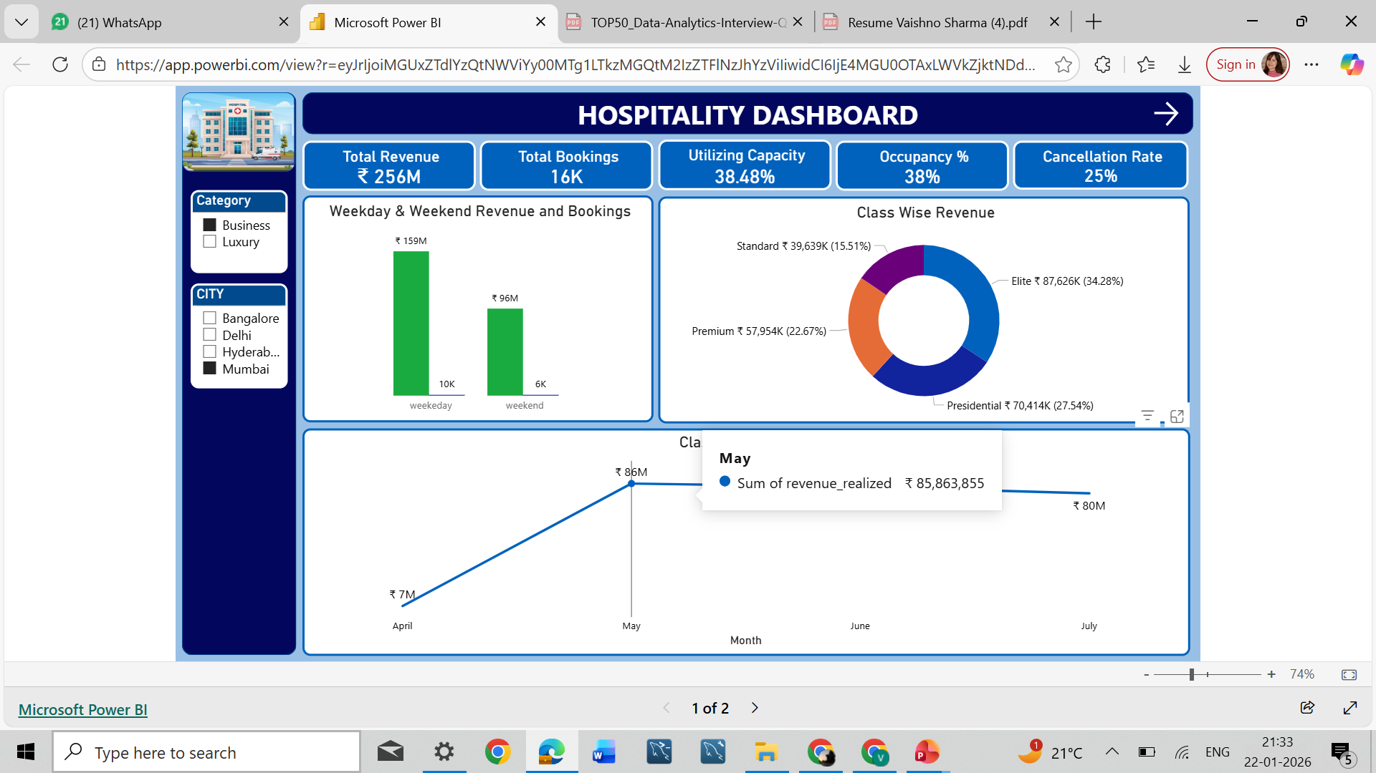
Power BI

Slide 14
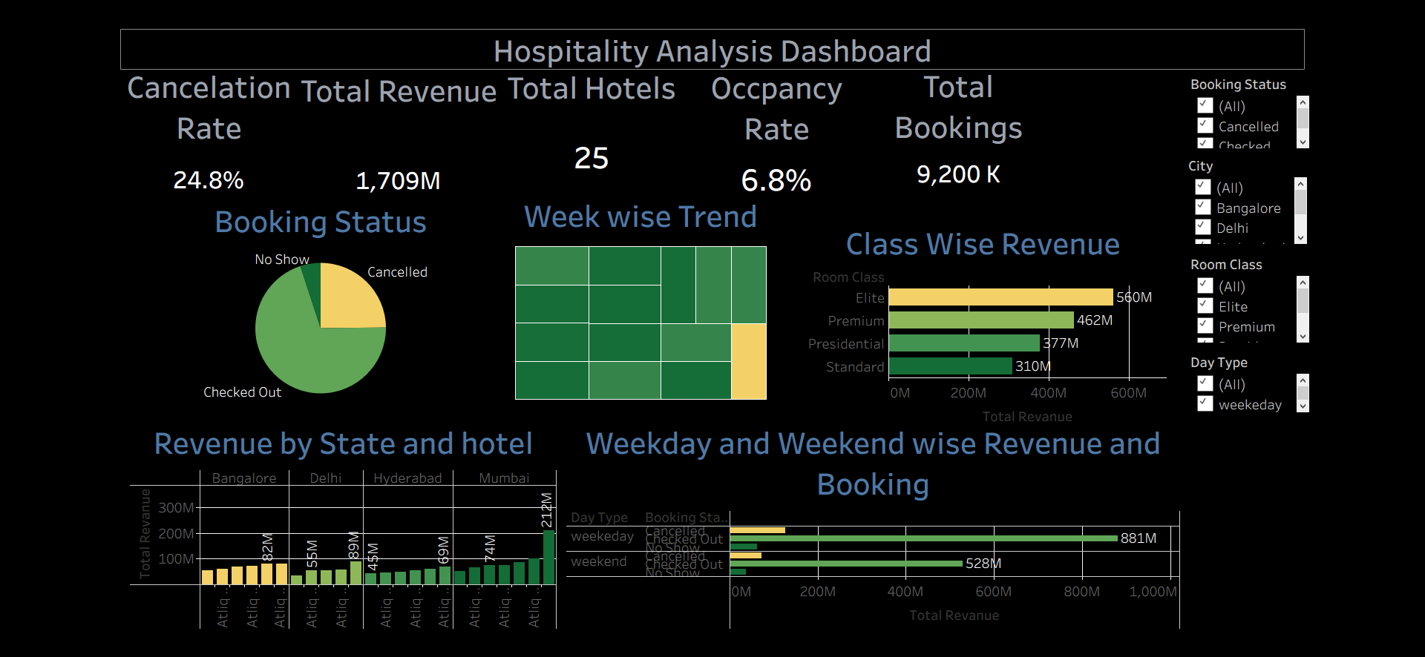
Tableau

Slide 15
Recommendations
Based on insights derived from the Power BI, Tableau, and Excel dashboards, several actionable recommendations can be made. Properties with consistently low occupancy rates should focus on targeted promotions and demand-generation strategies during off-peak periods. Hotels showing high occupancy but lower ADR can improve pricing strategies to maximize revenue without impacting demand. Management should prioritize cities and properties with higher RevPAR, as they indicate optimal balance between pricing and occupancy. Regular monitoring of these KPIs through dashboards will help stakeholders quickly respond to market changes and optimize operational and pricing decisions.

Slide 16
Conclusion
In conclusion, this project demonstrates how data analytics tools can be effectively used to transform hospitality data into actionable business insights. By integrating Excel, Tableau, and Power BI dashboards, the analysis provides a comprehensive view of revenue performance, demand trends, and pricing efficiency. The dashboards serve as a single source of truth for stakeholders, enabling faster decision-making and improved strategic planning. This data-driven approach helps hospitality businesses enhance profitability, optimize resource utilization, and maintain a competitive advantage.

Slide 17
Thank You!

